Slide 1
YggFinance
By Yggdrasil Creations: Blake Hudson Alan Holman Austin Kerr

Slide 2
Table of Contents
Introduction
Technology
Design
User Interface
Services
Building & Deployment
Known Bugs
Future Work

Slide 3
Introduction - What is YggFinance?
YggFinance Personal Finance Web Application
Monthly Budgeting
Savings Planning
Net Worth Tracking.

Slide 4










Technology
Microservices Architecture
Docker
Docker Compose
Base Docker Images
Node:14-alpine
Nginx:alpine
Version Management
GitHub [Source Code]
DockerHub [CIR for Releases]
Coded in JavaScript (using Node.js)
NPM dependencies:
Express (w/multer)
CSV-Parser
React
Material UI (w/ table-edit)
Create-React-App Tool dependencies

Slide 5












Technology (cont.)
LocalStorage Client Side Data Persistence
HTTP Communication
Mainly JSON
One Request with Multipart Form Data
LocalTunnel Proxy Tunneling
Lots of Config Files
Some Bash Scripts
Development Environments
OS: Windows 10 & Linux
IDE: VSCode
Communication: Discord
Documentation
Google Docs / Slides
app.diagrams.net
Markdown

Slide 6
Design
Frontend:
Single Page Web Application
Backend:
Containerized Microservices

Slide 7
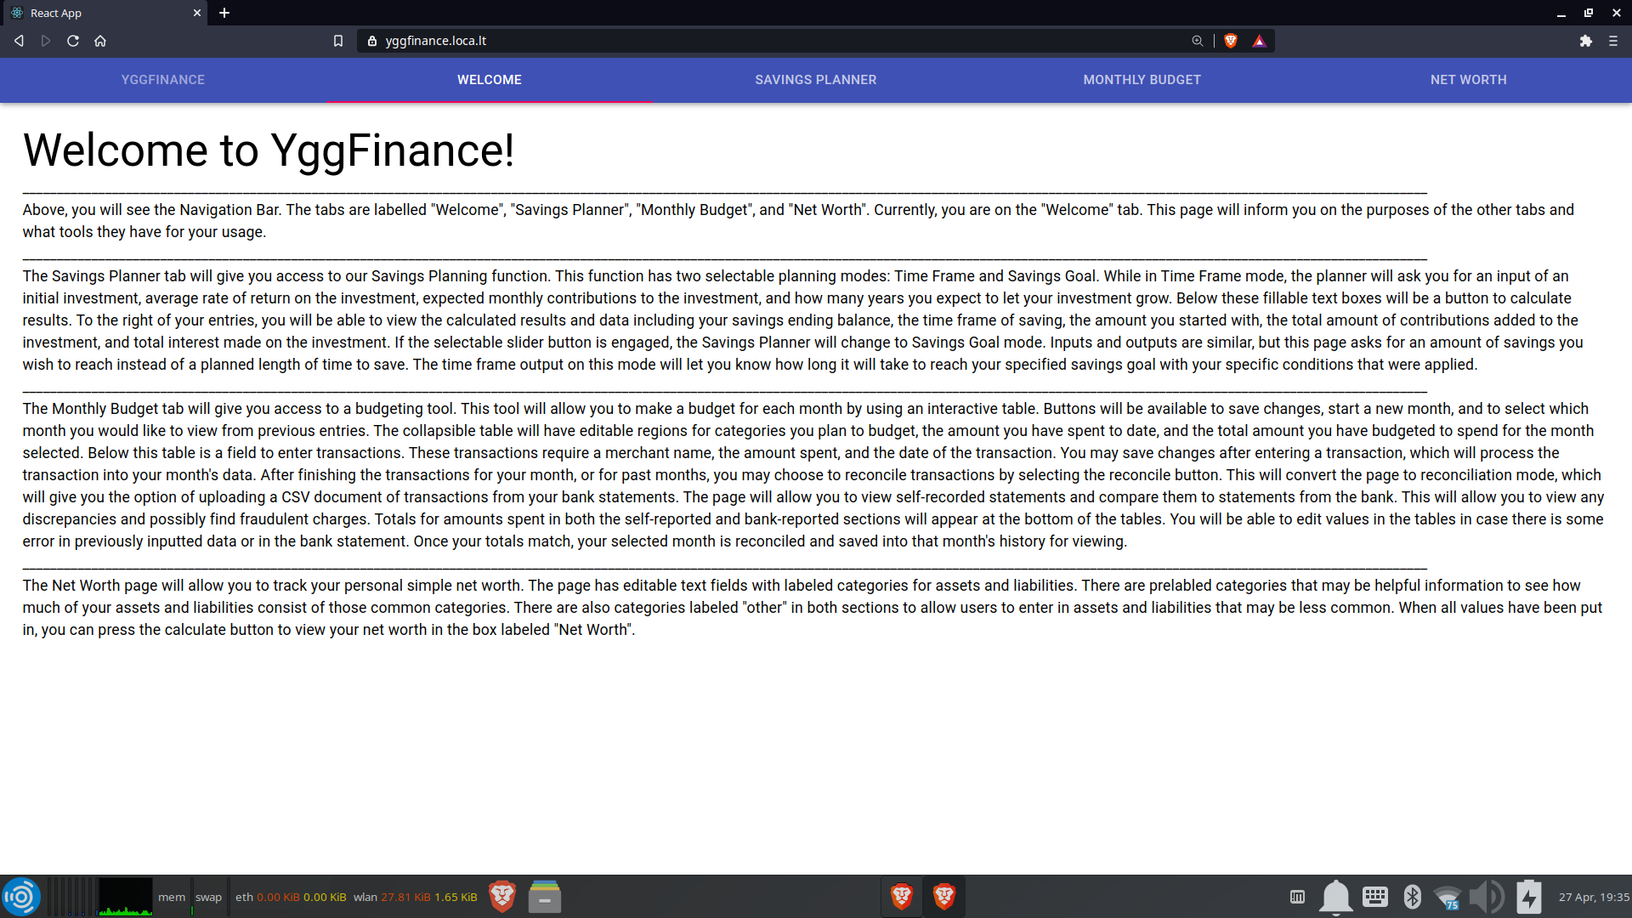
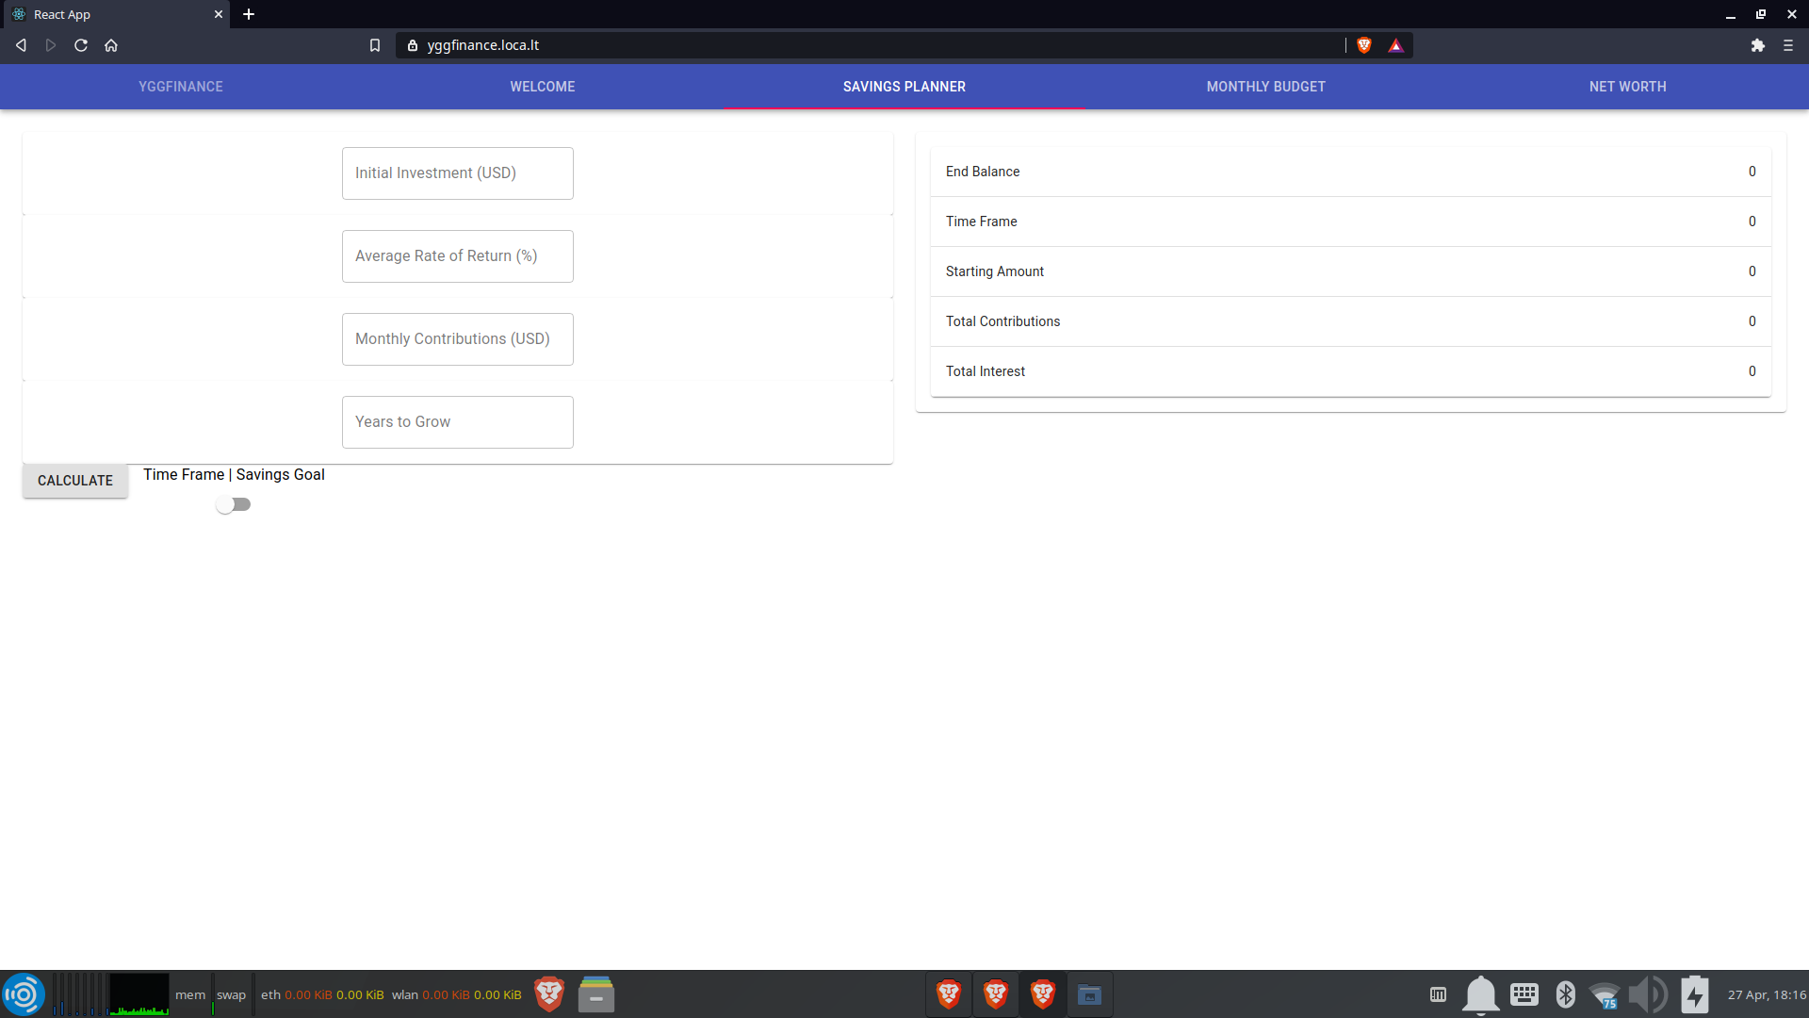
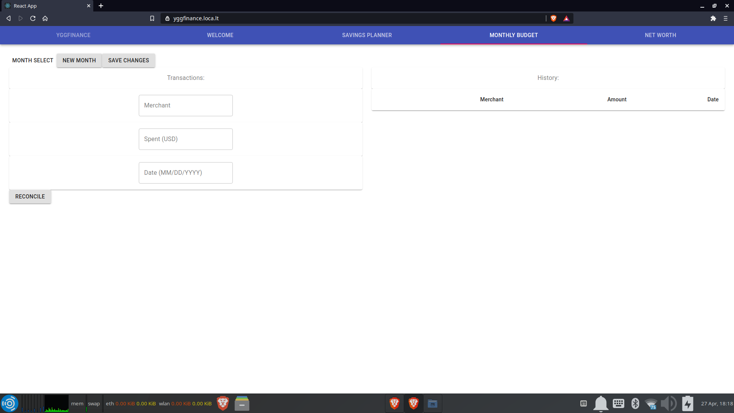
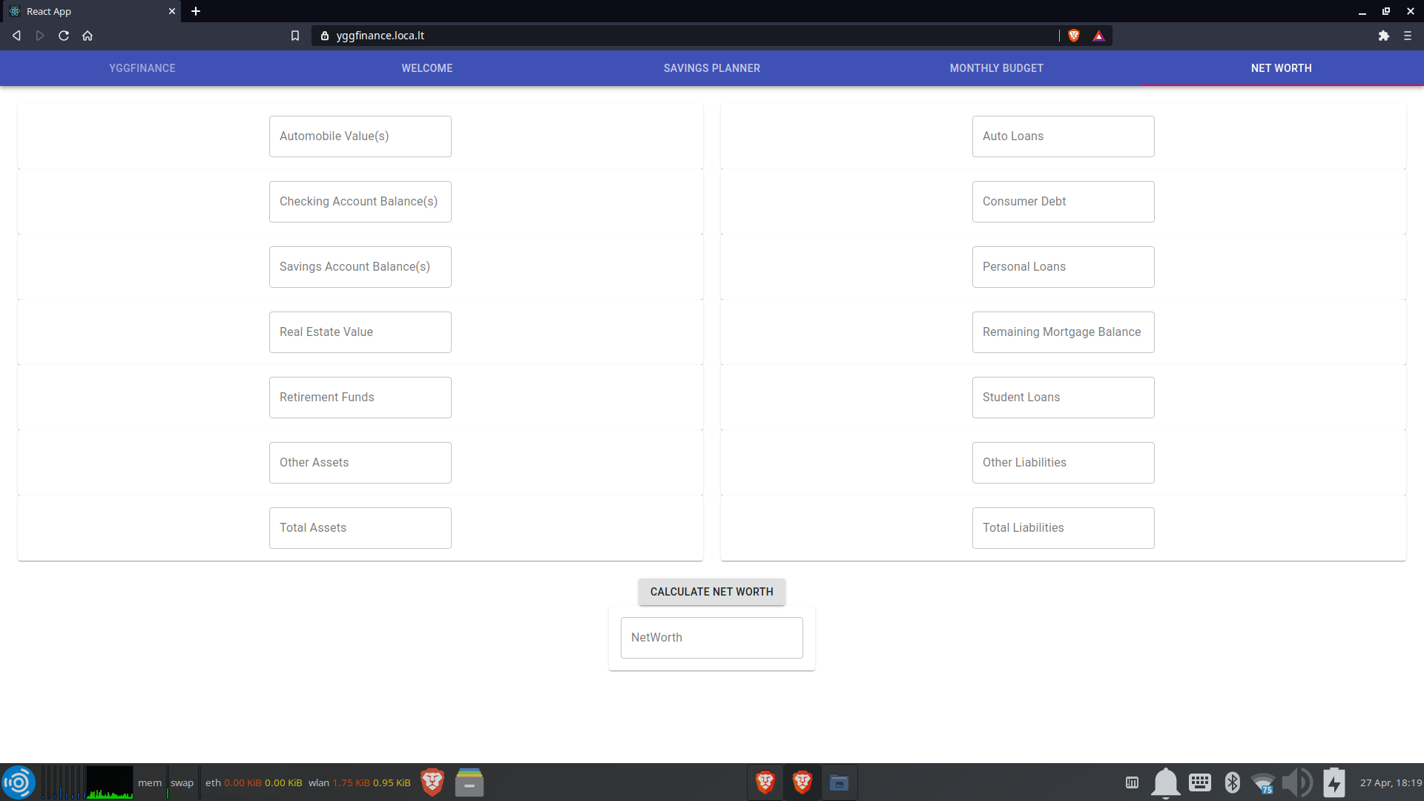
Design - User Interface
Welcome Page
Savings Planner Page
Monthly Budget Page
Net Worth Page

Slide 8
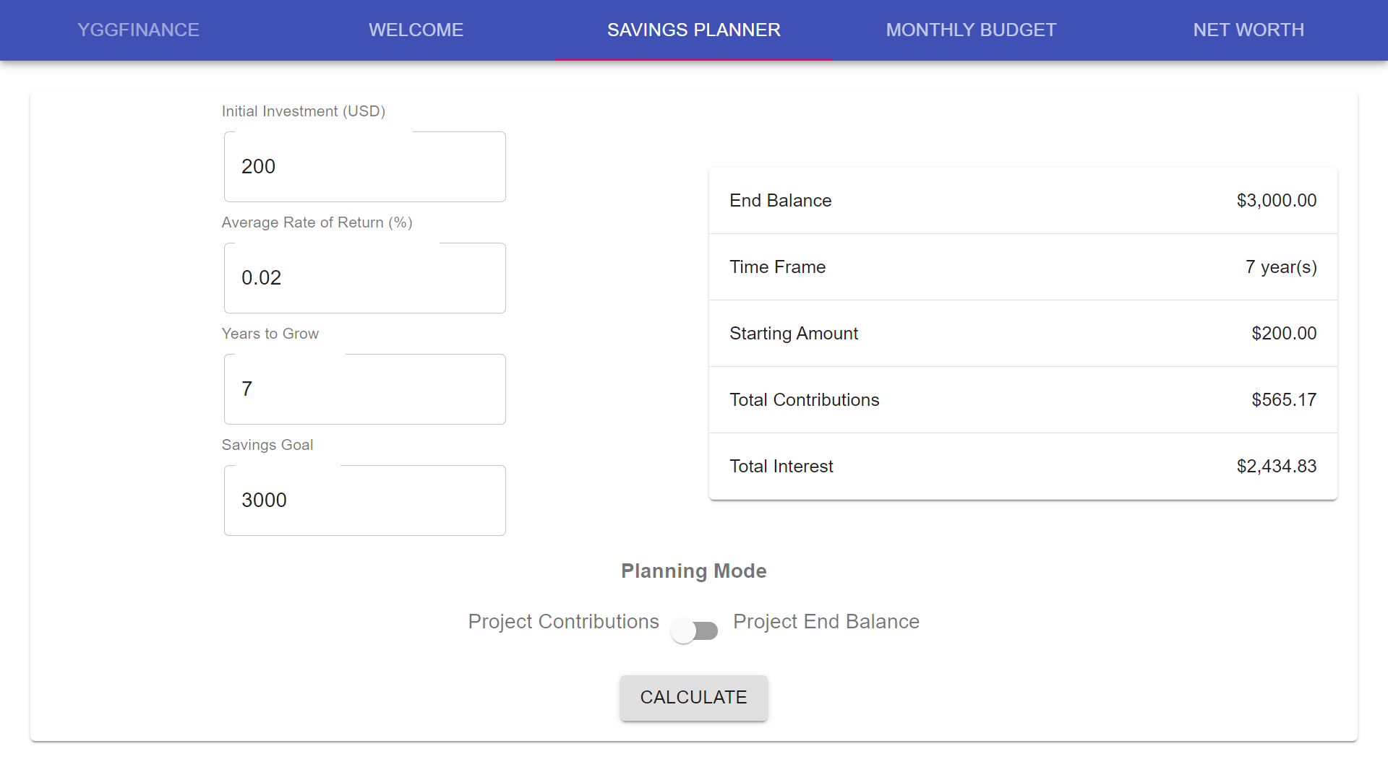
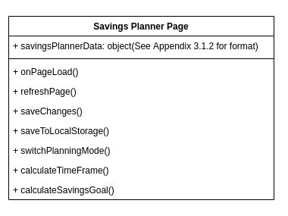
Design - User Interface
Savings Planner Page

Slide 9
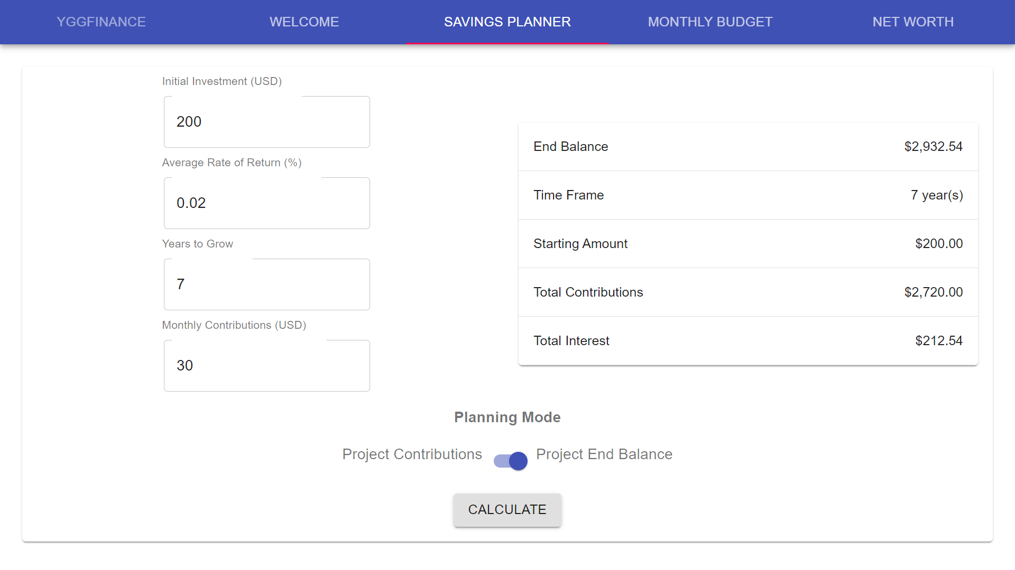
Design - User Interface
Savings Planner Page

Slide 10
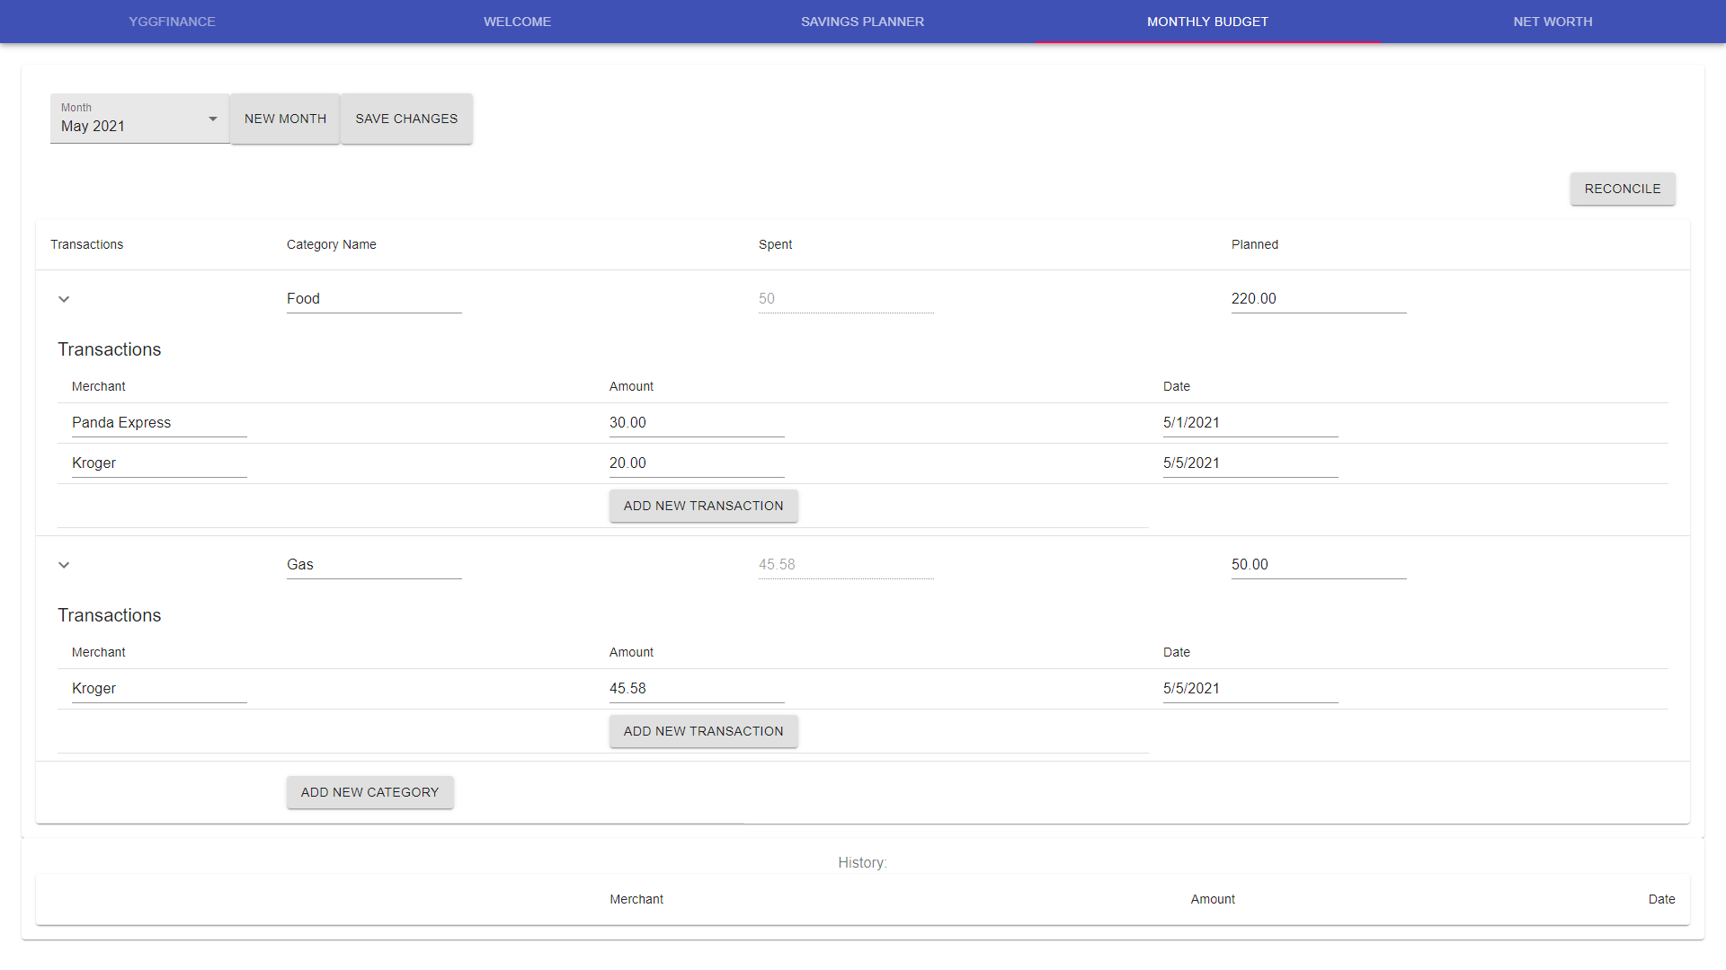
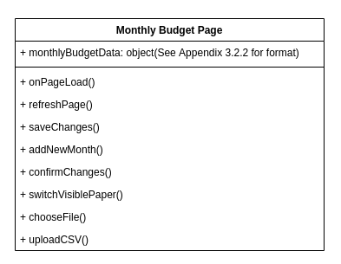
Design - User Interface
Monthly Budget Page

Slide 11
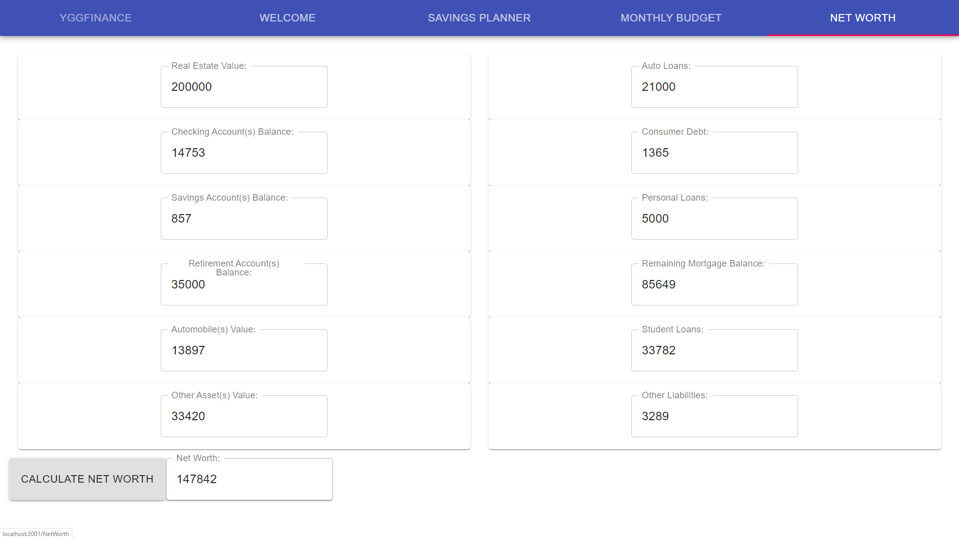
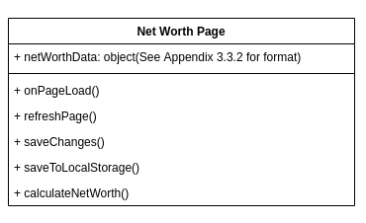
Design - User Interface
Net Worth Page

Slide 12
Design - User Interface (LocalStorage)
So… if we get around to it, will include a diagram of how we’re storing the data in localStorage

Slide 13
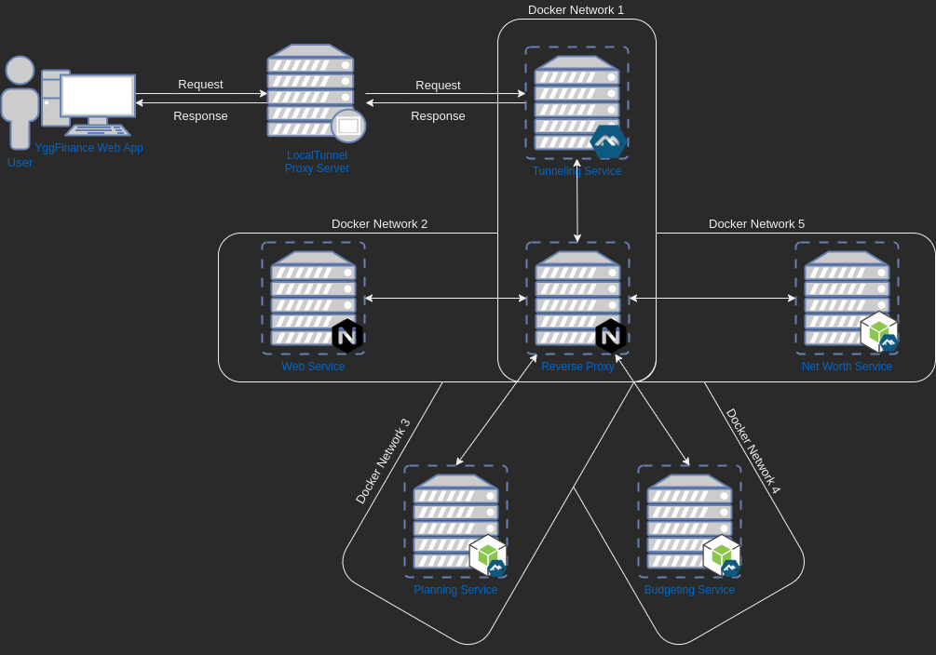
Design - Services
Planning Service
Budgeting Service
Net Worth Service

Slide 14
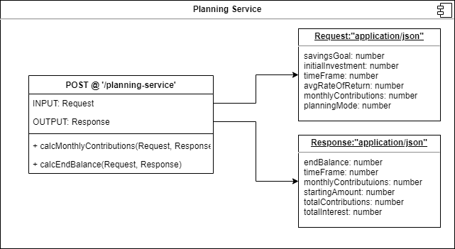
Design - Services
(Planning Service)

Slide 15
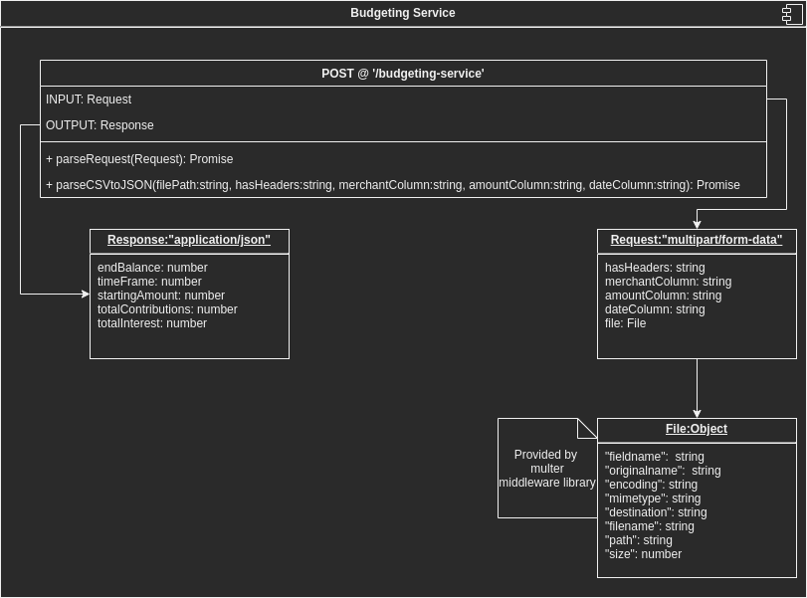
Design - Services
(Budgeting Service)

Slide 16
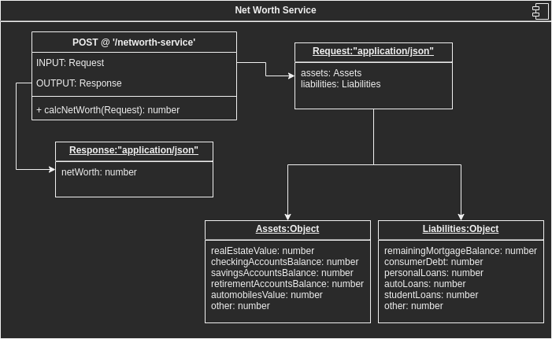
Design - Services
(Net Worth Service)

Slide 17
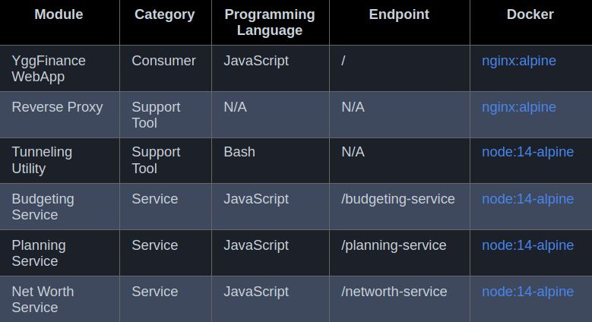
Design - Support Tools
Tunneling Utility:
Tunnels requests forwarded from the proxy server to the Reverse Proxy container
Reverse Proxy:
Redirects requests made to application endpoints
Forwards the redirected request to the correct Service container

Slide 18
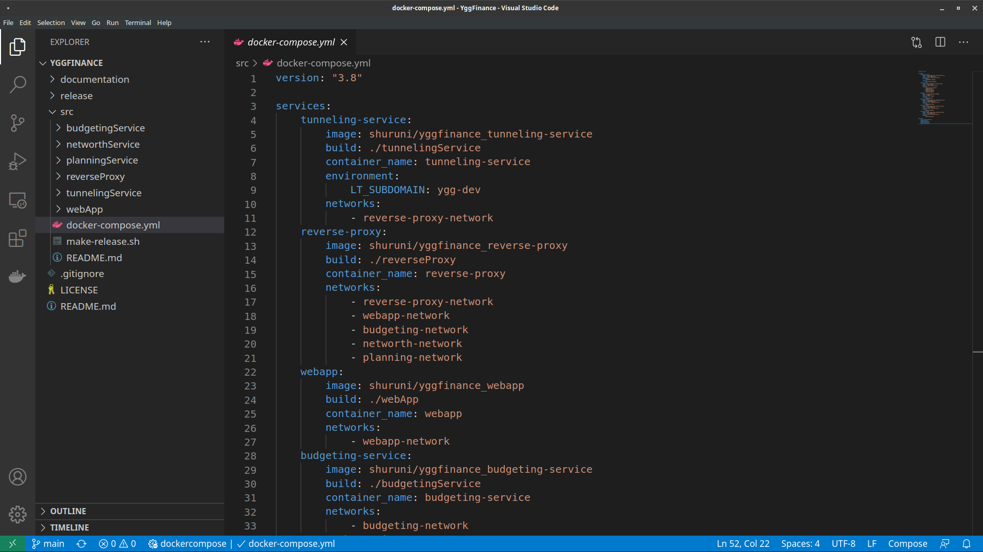
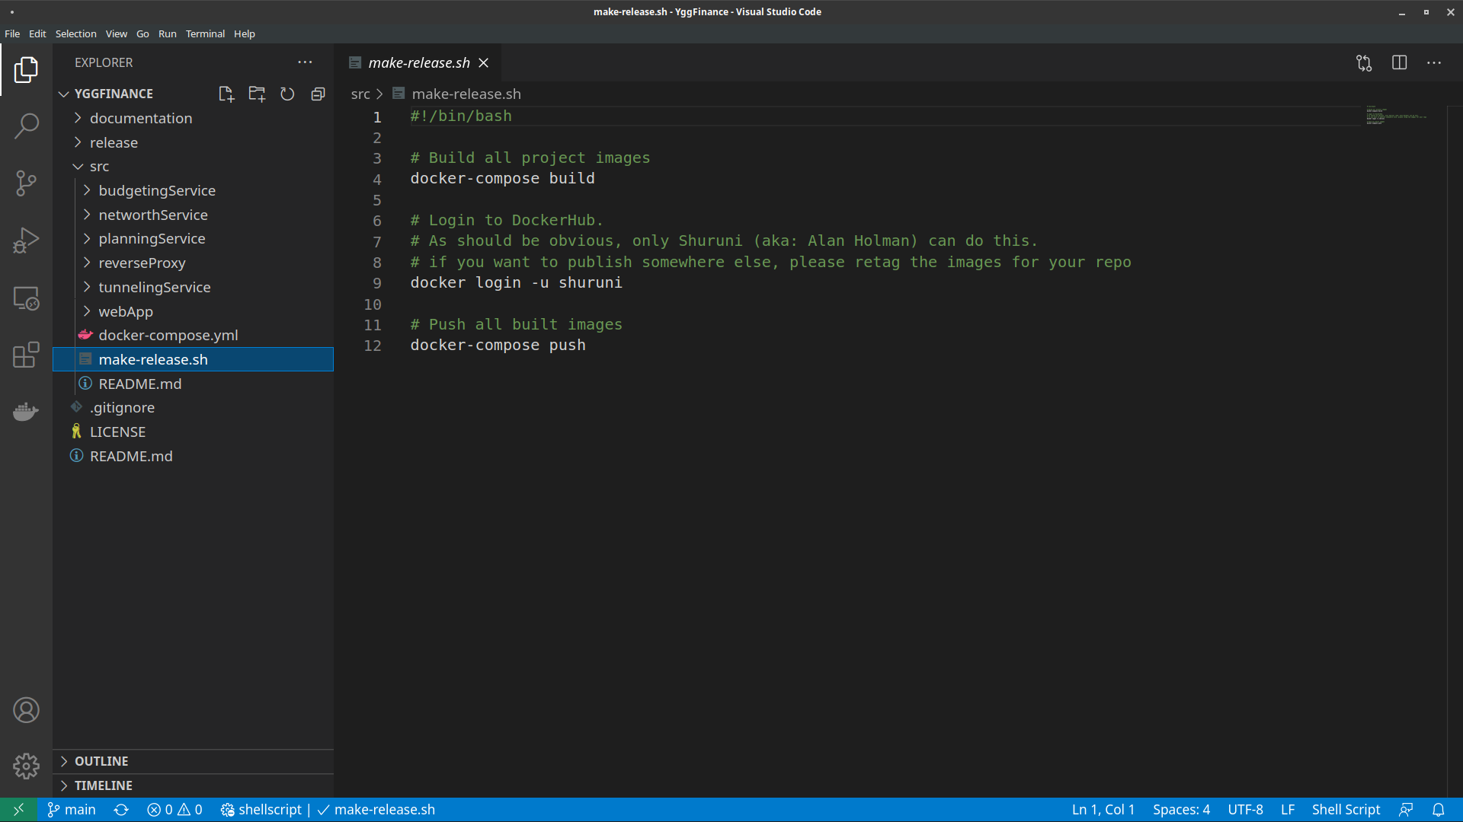
Building
Requires Docker & Docker Compose
Optionally requires Bash for release script
In the src Directory...
Building: docker-compose build
Releasing: bash make-release.sh＊
＊requires authentication or configuration (see report for details)

Slide 19
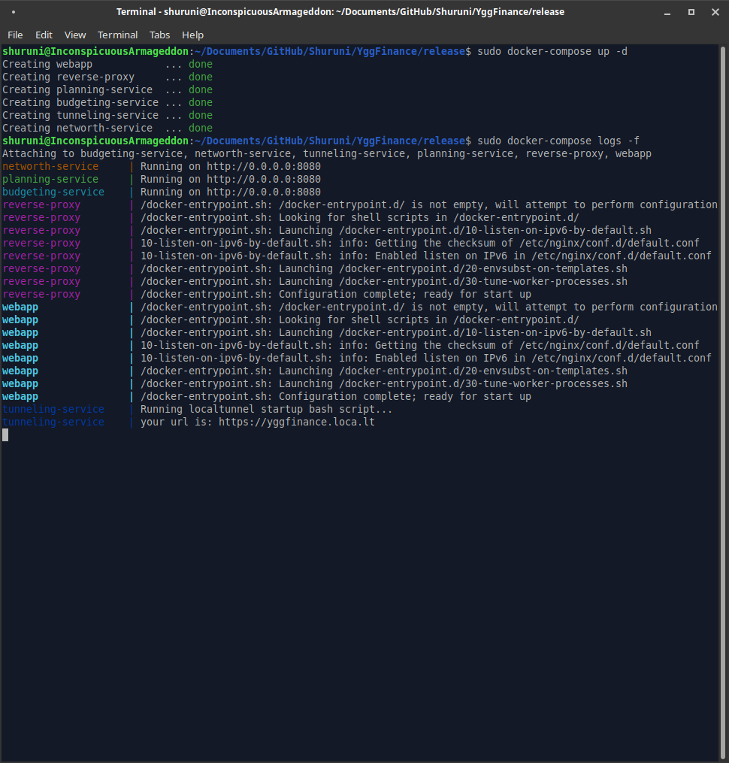
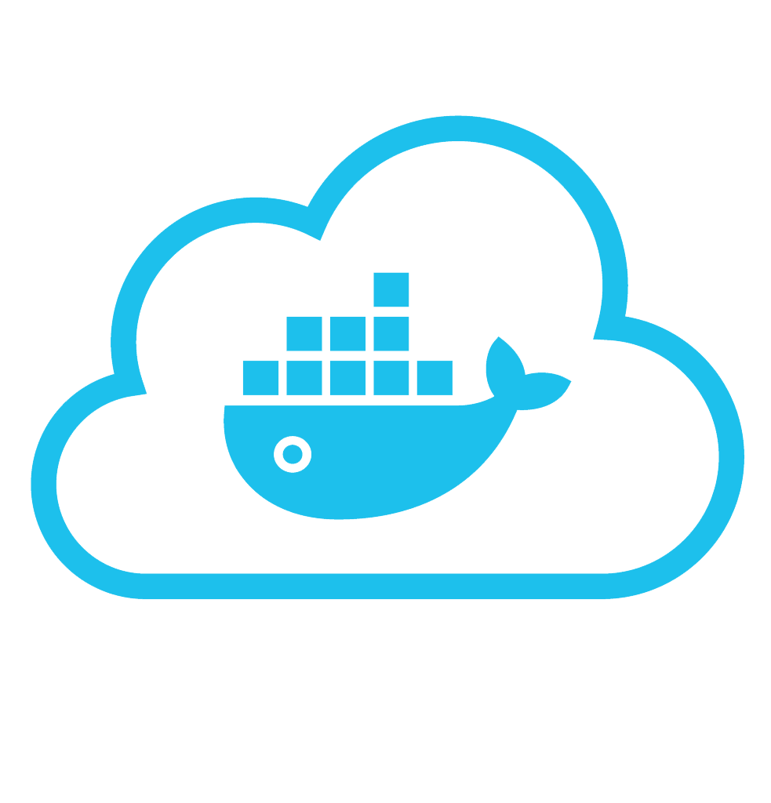
Deployment
Deployable Anywhere running Docker & Docker Compose
In the release Directory...
Running: docker-compose up -d
Monitoring: docker-compose logs -f
Tearing Down: docker-compose down

Slide 20
Known Bugs
01
Reconcile feature and CSV upload
02
Data Validation
03
Lags when entering information

Slide 21
Future Work
Savings Planner
Goal setting and tracking
Portfolio Analyzer
Investment risk levels
Account Linking
Automatic data tracking
Credit card/Bank compatibility

Slide 22
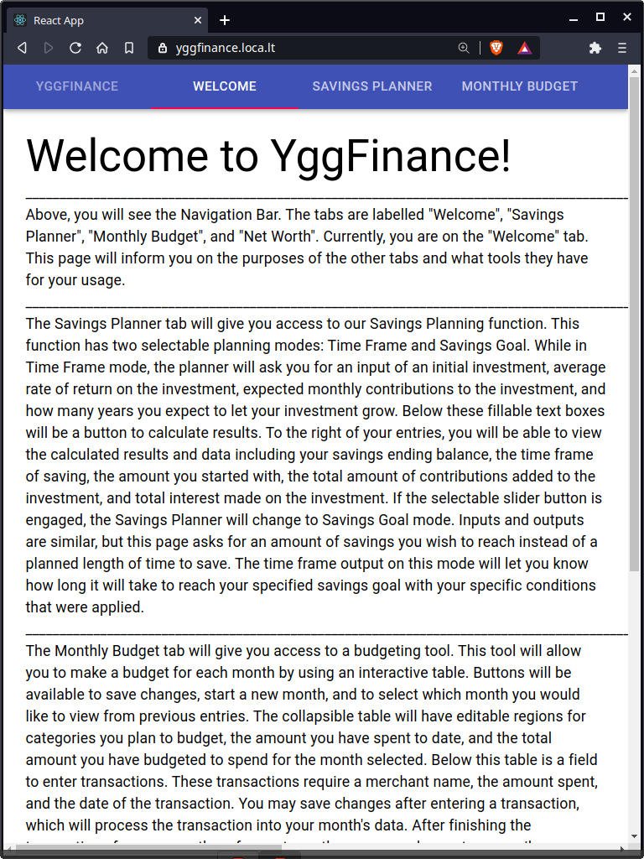
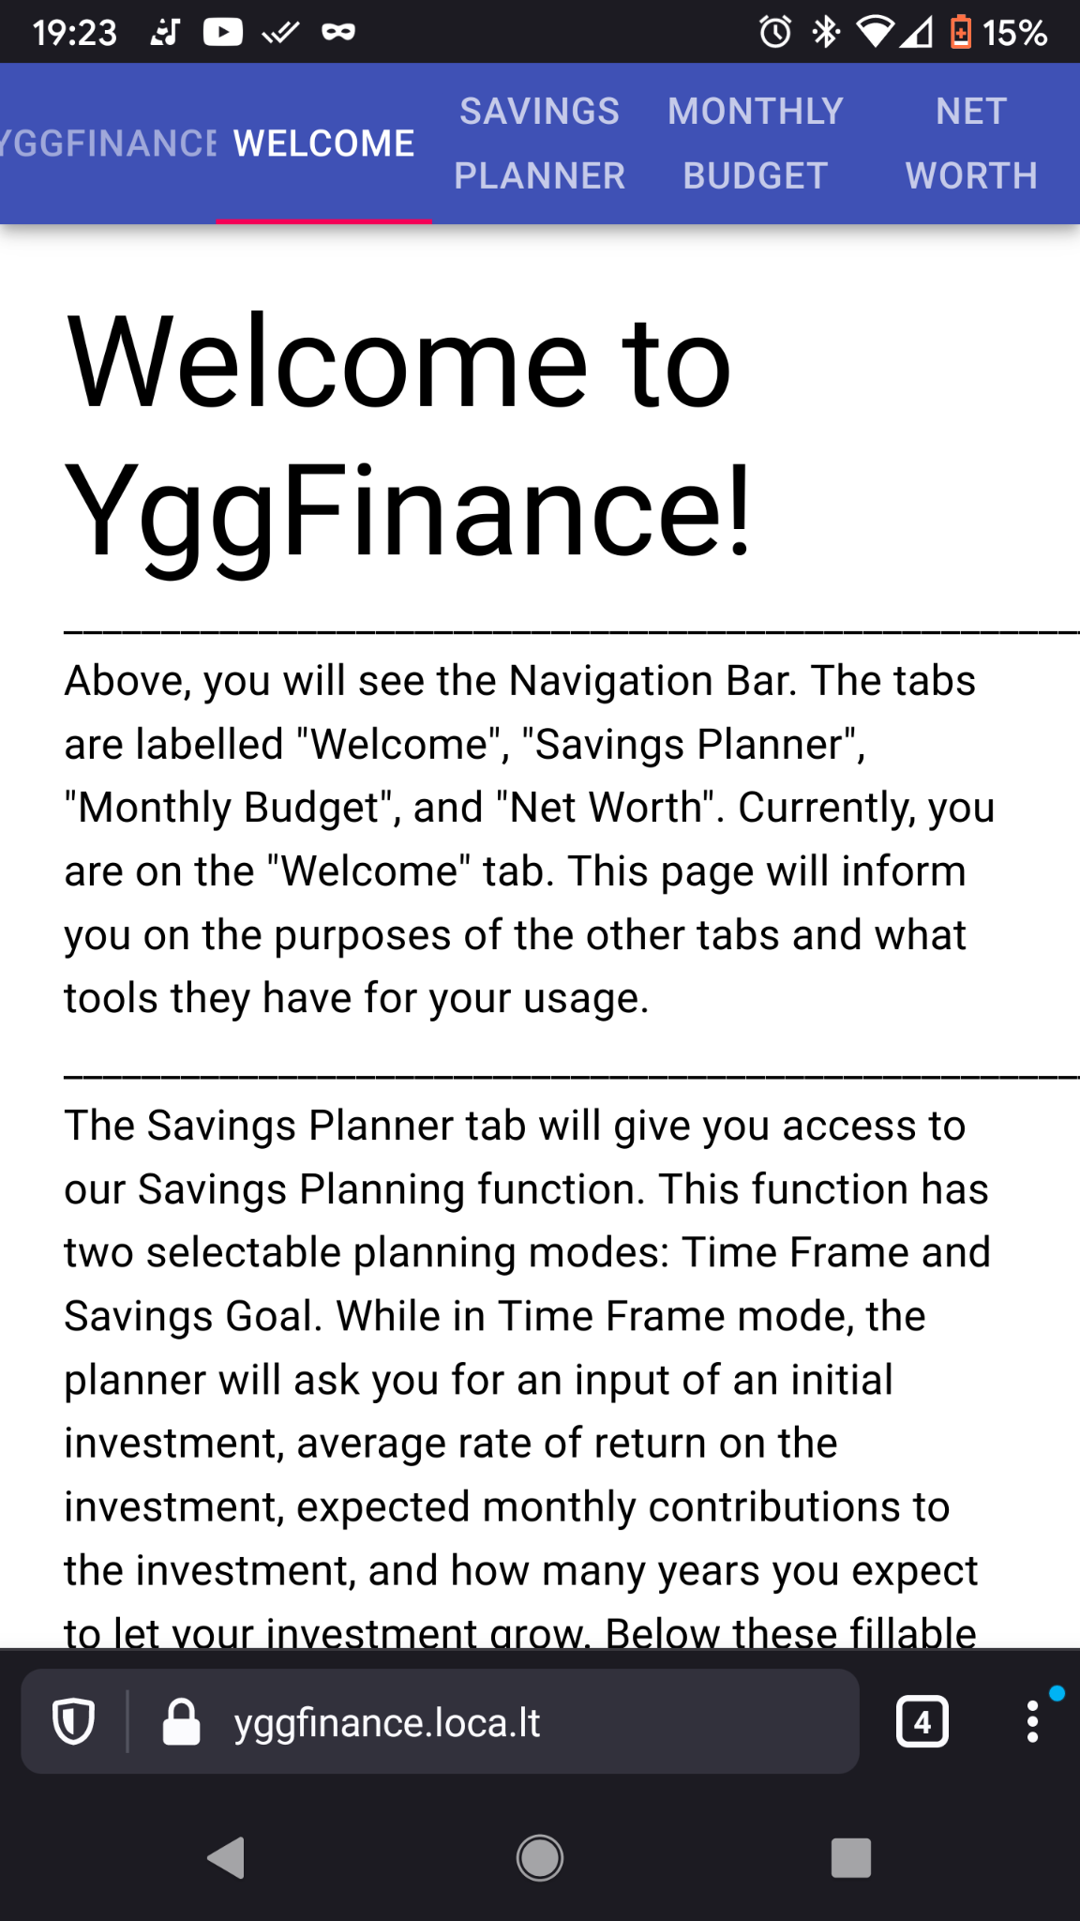
Demo Time!
Let’s Take a look at it now!
https://yggfinance.loca.lt

Slide 23
Thank you!
Questions?

